Slide 1
Retail Recruitment Update
Liberty, SC
Notes:
Add City Name and State
Our tag line

Slide 2
Retail Strategies
INTRODUCTION
Founded in 2011 as a full-service advisory firm that works with municipalities on business recruitment through commercial real estate connections and networks.
Retail Recruitment
Retail Academy
Downtown Strategies
Small Business Support
We actively recruit retail businesses into the markets we serve by bridging the private/public gap.
Our team employs a commercial broker’s mindset with a fiduciary responsibility for our municipal clients.
Partnership with Liberty began in 2023.
Matt Jaeger, Portfolio Director
205-792-6483
mjaeger@retailstrategies.com
Cole Clark, Retail Recruitment Coordinator
cole@retailstrategies.com

Slide 3
Retail Recruitment – Our Process
Retail Strategies
Data & Demographic Analysis: We refresh market data for the Liberty custom trade area annually. This allows our team to see the market from the same perspective as national retailers.
Boots on the Ground: Annually we visit the market to update our inventory of real estate assets in Liberty. Throughout the year we work to develop and nourish relationships with local brokers, developers and property owners.
Pleasant Persistence: Day after day, week after week, year after year our team remains pleasantly persistent with national retail brands promoting viable sites in Liberty. National retail brand reps are constantly receiving sites from around the country – we put Liberty at the front of the line.
Trade Show Representation: Our team travels across the country to ICSC and Retail Live! shows to promote Liberty and the opportunities in the market.
Investment Multiplier: We act as an extension of the City’s on-going economic development efforts. Our goal is to multiply the results of your team by focusing specifically on retail recruitment.
Relationship Agent: Our team is actively looking for ways to leverage our deep bench of industry relationships in order to promote retail opportunities in Liberty.
Matt Jaeger, Portfolio Director
205-792-6483
mjaeger@retailstrategies.com
Cole Clark, Retail Recruitment Coordinator
cole@retailstrategies.com

Slide 4
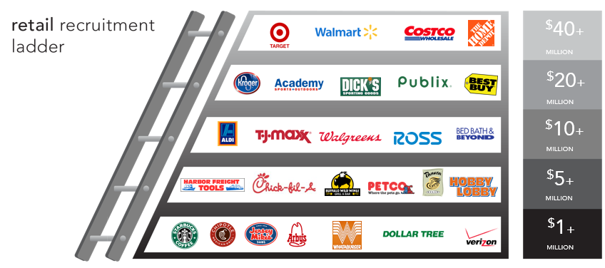
Why Should a Municipality Invest Resources in Retail?
Liberty, SC – Retail Recruitment Ladder
Retail builds on retail. Retail economic impact adds up quickly. Retail attracts the workforce that attracts the primary jobs. Retail influences executives looking to locate their company in your community. Retail enhances the quality of life. Quality of life encourages the future growth of your community.

Slide 5
Liberty, SC – Retail Recruitment Partnership Timeline
February 2023 – Partnership contract executed.
March 2023 – Discovery Phase begins.
April 2023 – Retail Strategies team performs initial market tour of Liberty, SC.
May 2023 – ICSC Las Vegas
July 2023 – Liberty, SC retail recruitment plan is presented to City leadership.
July 2023 – Recruitment phase begins.
October 2023 – ICSC Southeast (Atlanta, GA).
October 2023 – Retail Strategies team develops intel for City’s traffic impact study on economic development.
December 2023 – Basecamp 4 introduced.
December 2023 – Liberty, SC point of contact changes.

Slide 6
Retail Strategies – Our Toolbox
Retail Strategies uses the following industry-standard tools to help leverage opportunities in Liberty:
Custom Trade Area Design
Mobile Data Tracking
Gap Analysis (Leakage report)
ESRI Tapestry Segmentation Profiles
Boots On The Ground Research
Matt Jaeger, Portfolio Director
205-792-6483
mjaeger@retailstrategies.com
Cole Clark, Retail Recruitment Coordinator
cole@retailstrategies.com

Slide 7
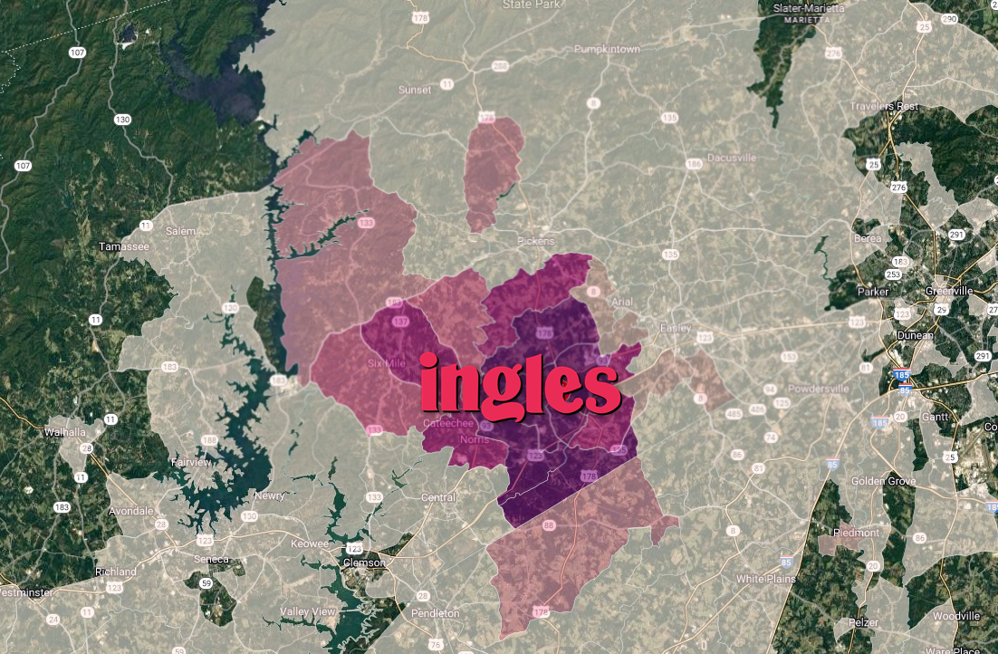
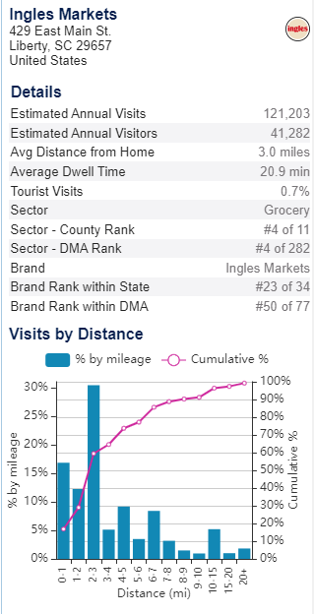
Liberty, SC – Mobile Data Tracking Example

Slide 8
Liberty, SC – Gap Analysis (Leakage Report)
Our team uses this tool to analyze the estimated market supply and the estimated market demand for the Liberty, SC CTA (custom trade area). Here are some highlights, all figures are annual:
Grocery Stores: Over $80,000,000 opportunity gap.
Gas Stations: Over $52,000,000 opportunity gap.
Clothing/Clothing Accessories: Over $27,000,000 opportunity gap.
General Merchandise Stores: Over $76,000,000 opportunity gap.
Food Service (All Types): Over $56,000,000 opportunity gap.
Furniture & Home Furnishings Stores: Over $16,000,000 opportunity gap.
Automotive Parts: Over $14,000,000 opportunity gap.

Slide 9
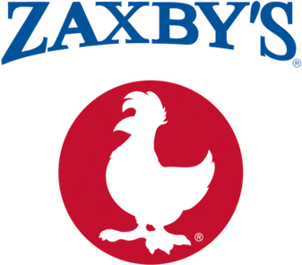
Liberty, SC Notes – Active Recruitment Prospects
National Chicken QSR: During our discovery phase this retailer emerged as a top prospect. The Retail Strategies began engaging their corporate real estate directory at the beginning of our recruitment phase (July 2023). Near the end of the year, the retailers team confirmed that they planned to tour the market in Q1 of 2024 to evaluate potential sites and “personally experience Liberty”. Great progress here!
National Sandwich QSR: The Retail Strategies team has been actively engaged with the retailer’s corporate real estate team since the beginning of our recruitment phase. Initial feedback from the retailer is positive regarding Liberty – we are working to see if they are looking to expand in 2024 in the trade area.
Regional Burger QSR: This privately-owned brand historically looks favorably at smaller markets in the Carolinas. The owner confirmed that Liberty has not been on their radar in the past, however, they are willing to review sites shared by our team. Currently, they believe their 2024 pipeline is full, but that can change at any time. Our team continues to remain engaged with the retailer and continues to promote Liberty as a natural expansion market.
Regional Convenience Store: Retailer is beginning to expand across Georgia and South Carolina in 2024. Their initial expansion area will be along I-20 and south towards the coast. However, they anticipate further growth throughout 2024 and beyond. They are reviewing opportunities in the market and it’s important to consistently keep Liberty on their radar as they continue to expand.
National Beauty Retailer: Unfortunately, the brand has hit pause on opening new markets in 2024. They are solely focused on larger markets where they already have a presence.
National Hotel Developer: As you know, there is a good relationship between REDACTED and the developer for this brand. There is interest in developing a site in Liberty! We are staying in touch with the hotelier to assist with their process.

Slide 10
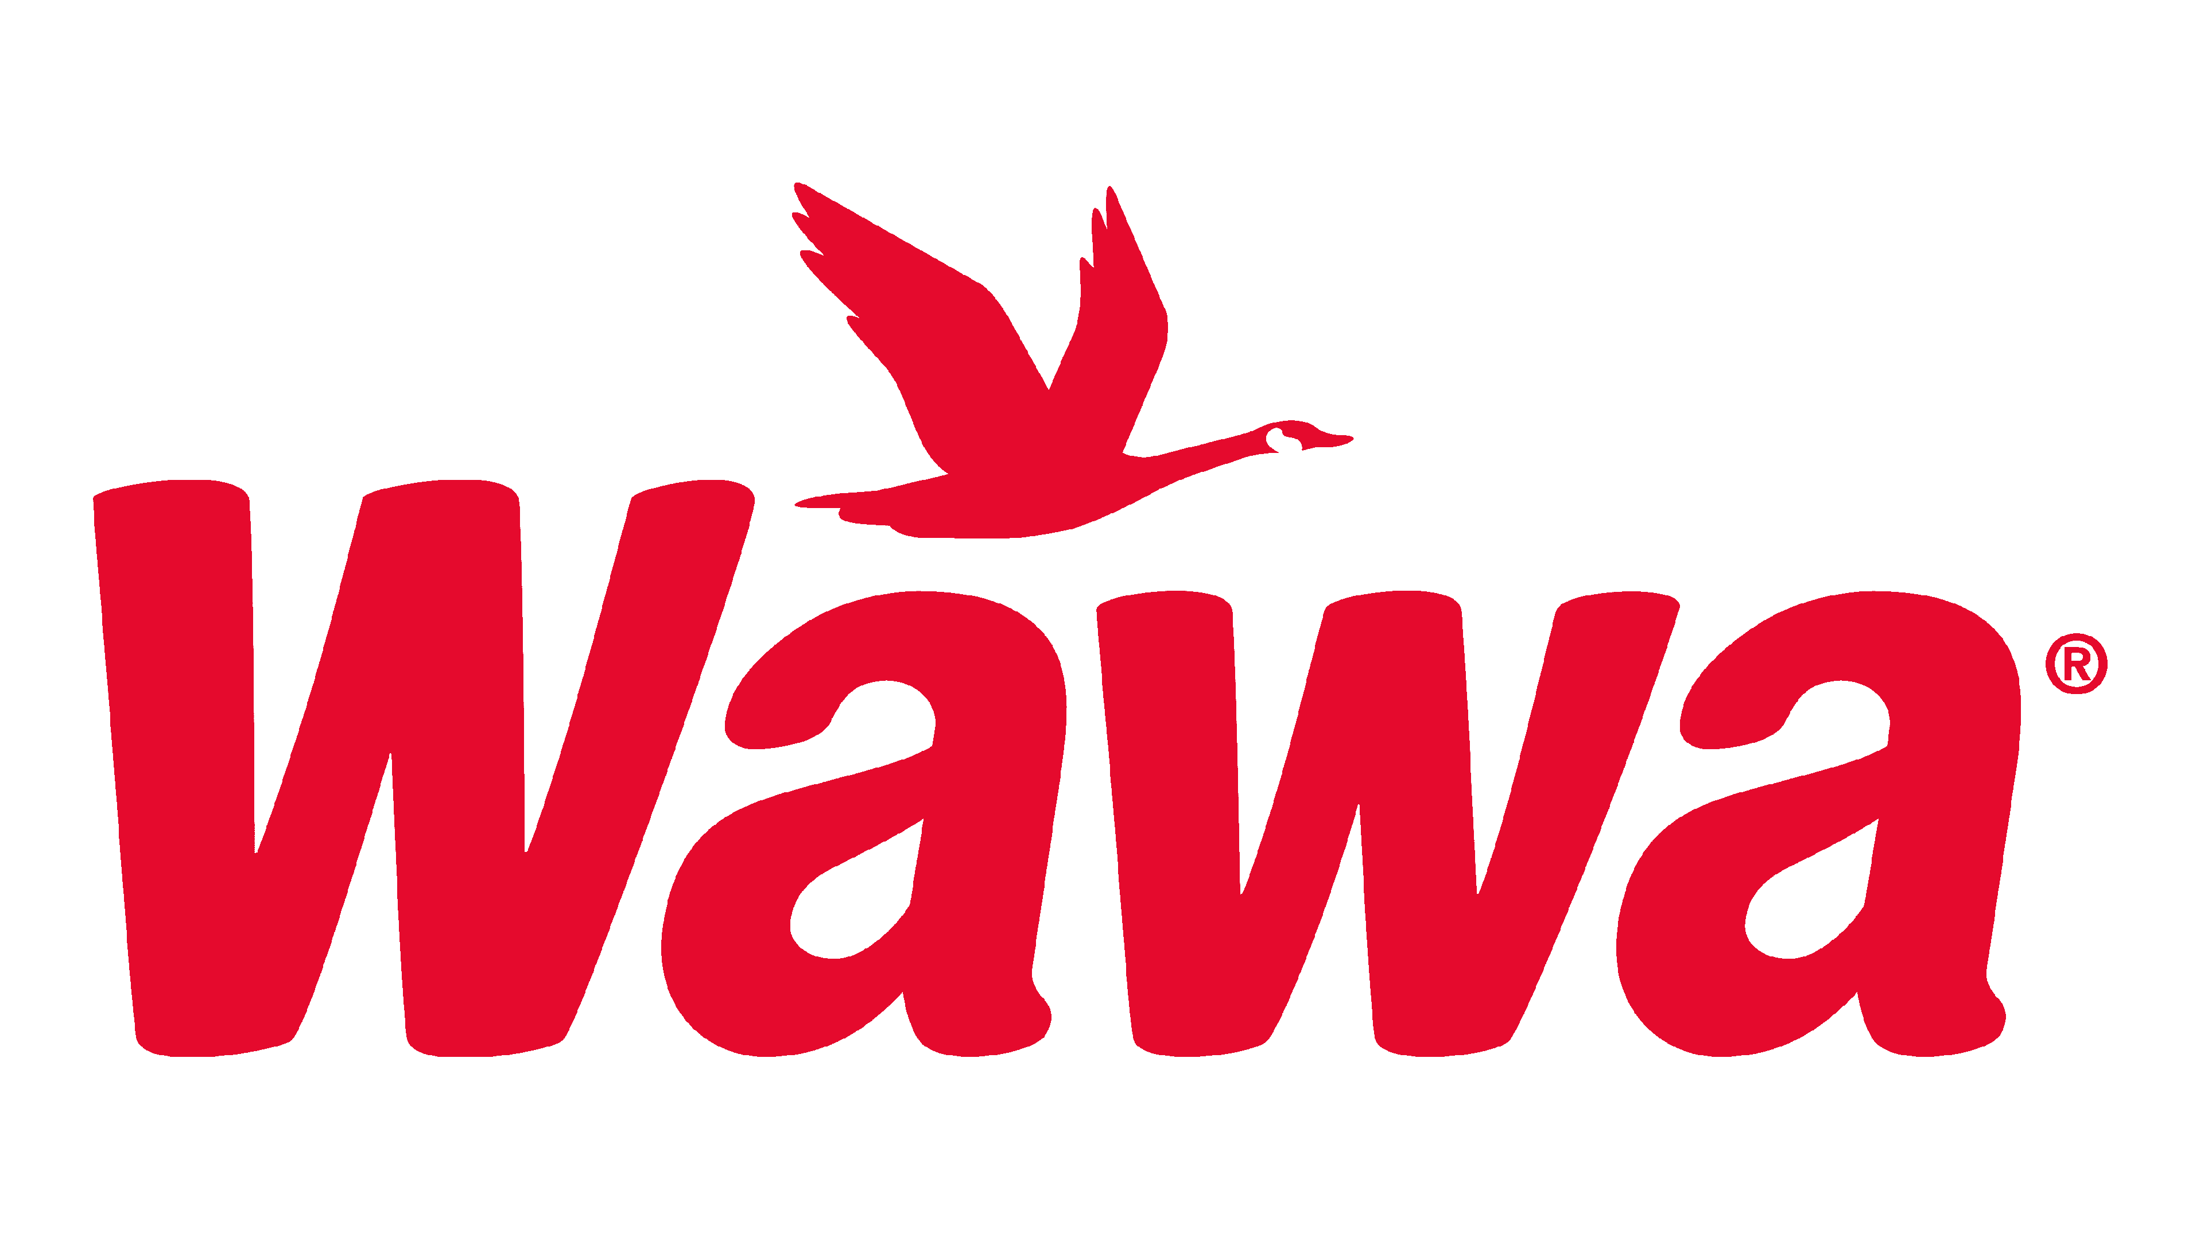
Liberty, SC Notes – Active Recruitment Prospects
New Fast-Casual Concept: This new concept is actively seeking franchisees in South Carolina and are aggressively filling their pipeline in 2024. Our team continues to promote opportunities in Liberty.
Full-Service Sports Bar & Grill: Brand has recently turned over their corporate real estate department. They like proximity to large state universities, and we continue to promote the Liberty market to their new real estate team.
National Convenience Store: Legendary east coast convenience store brand is actively expanding in the Carolinas. They are focused on major interstates first and in 2024 they are pushing into a number of I-95 markets in North Carolina. However, their team has confirmed with us that in 2025 they will focus on South Carolina and then beyond they will begin growing beyond the major interstate routes. We are working now to keep Liberty on their radar so that when the time is right, they will be familiar with the market.
National Donut QSR: This Texas-based brand is actively looking for additional franchisees in South Carolina. They have a REDACTED franchisee looking for opportunities and we are working directly with the corporate team to help them analyze Liberty.
Regional Carwash Brand: This brand, like many other carwash brands, is aggressively growing across the Carolinas region and the southeast. We are working directly with the corporate real estate team to assist with market data & traffic intel for the Liberty trade area.
National Auto Parts Retailer: Brand represents a clear gap in the trade area. They are currently reviewing market data & demographics and we look forward to getting their feedback on the market.

Slide 11
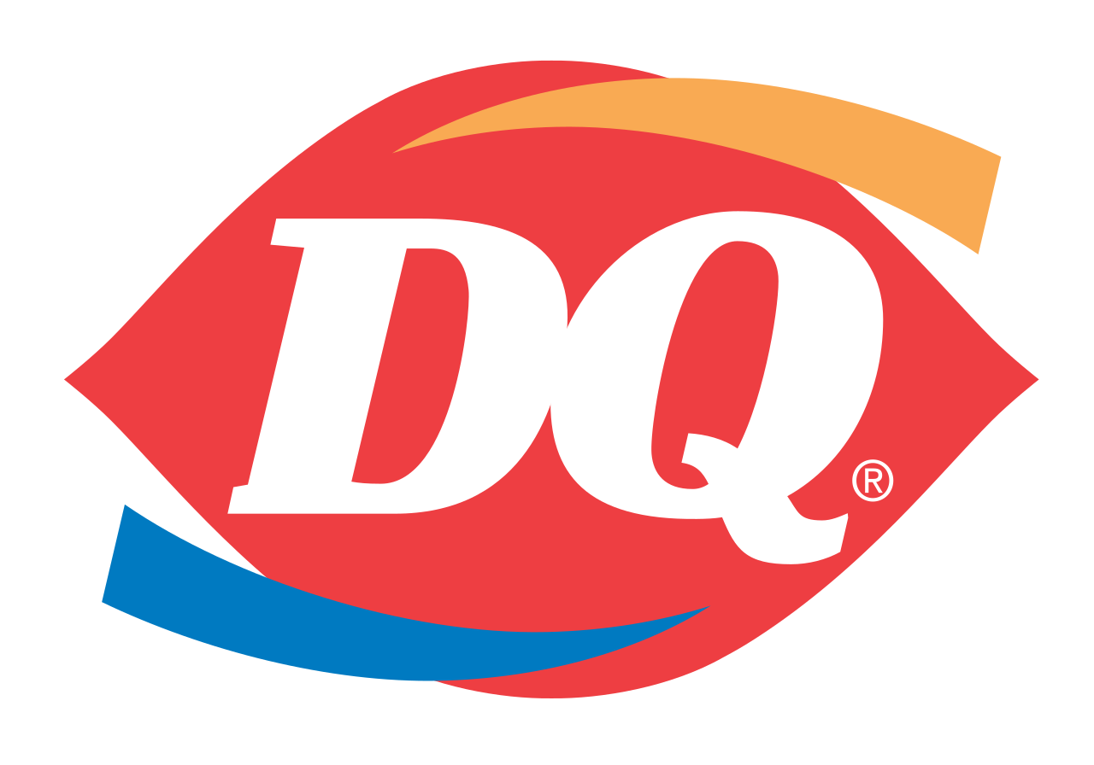
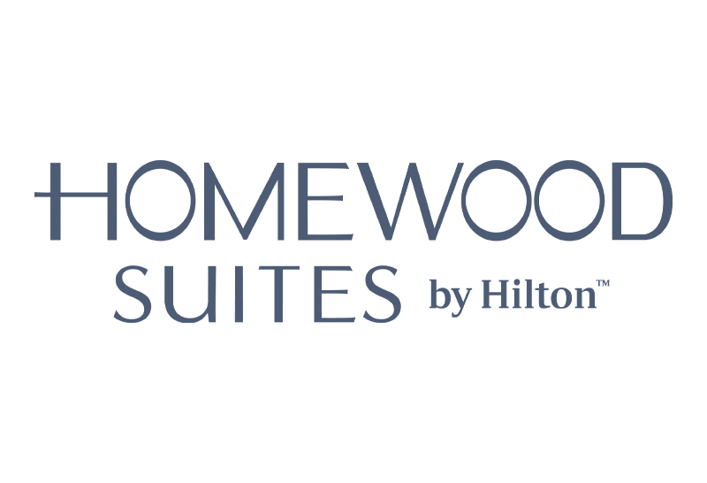
Liberty, SC Notes – Active Recruitment Prospects
National Burger & Ice Cream QSR: Retailer’s corporate real estate team has consistently provided favorable feedback about the Liberty market since the beginning of our recruitment phase. They are actively working with a pool of potential franchisees that could be a part of a Liberty development plan. They’ve asked that the Retail Strategies team continue to provide them with opportunities in the market as they work through their franchising process.
National Burger QSR: Brand’s real estate team is still reviewing market data and some initial sites. We are staying in touch to get their feedback as soon as possible.
Hotel Developer: Florida-based developer who is primarily focused on suite style hotels, has expressed interest in the market due to the proximity to Clemson University. They have developed several REDACTED and REDACTED in Florida, North Carolina, and Tennessee.
Regional Auto Service Provider: This brand continues to expand. They are currently reviewing market data & demographics to see if the market is viable for their concept. We are staying in touch to get additional feedback.
Additional Prospects, Awaiting Feedback:
National Carwash
National Coffee QSR
National Dental Provider
National Dental Provider
National Fitness User
National Fitness User
National Coffee QSR
Regional Bank
National Coffee QSR
National Burger QSR

Slide 12
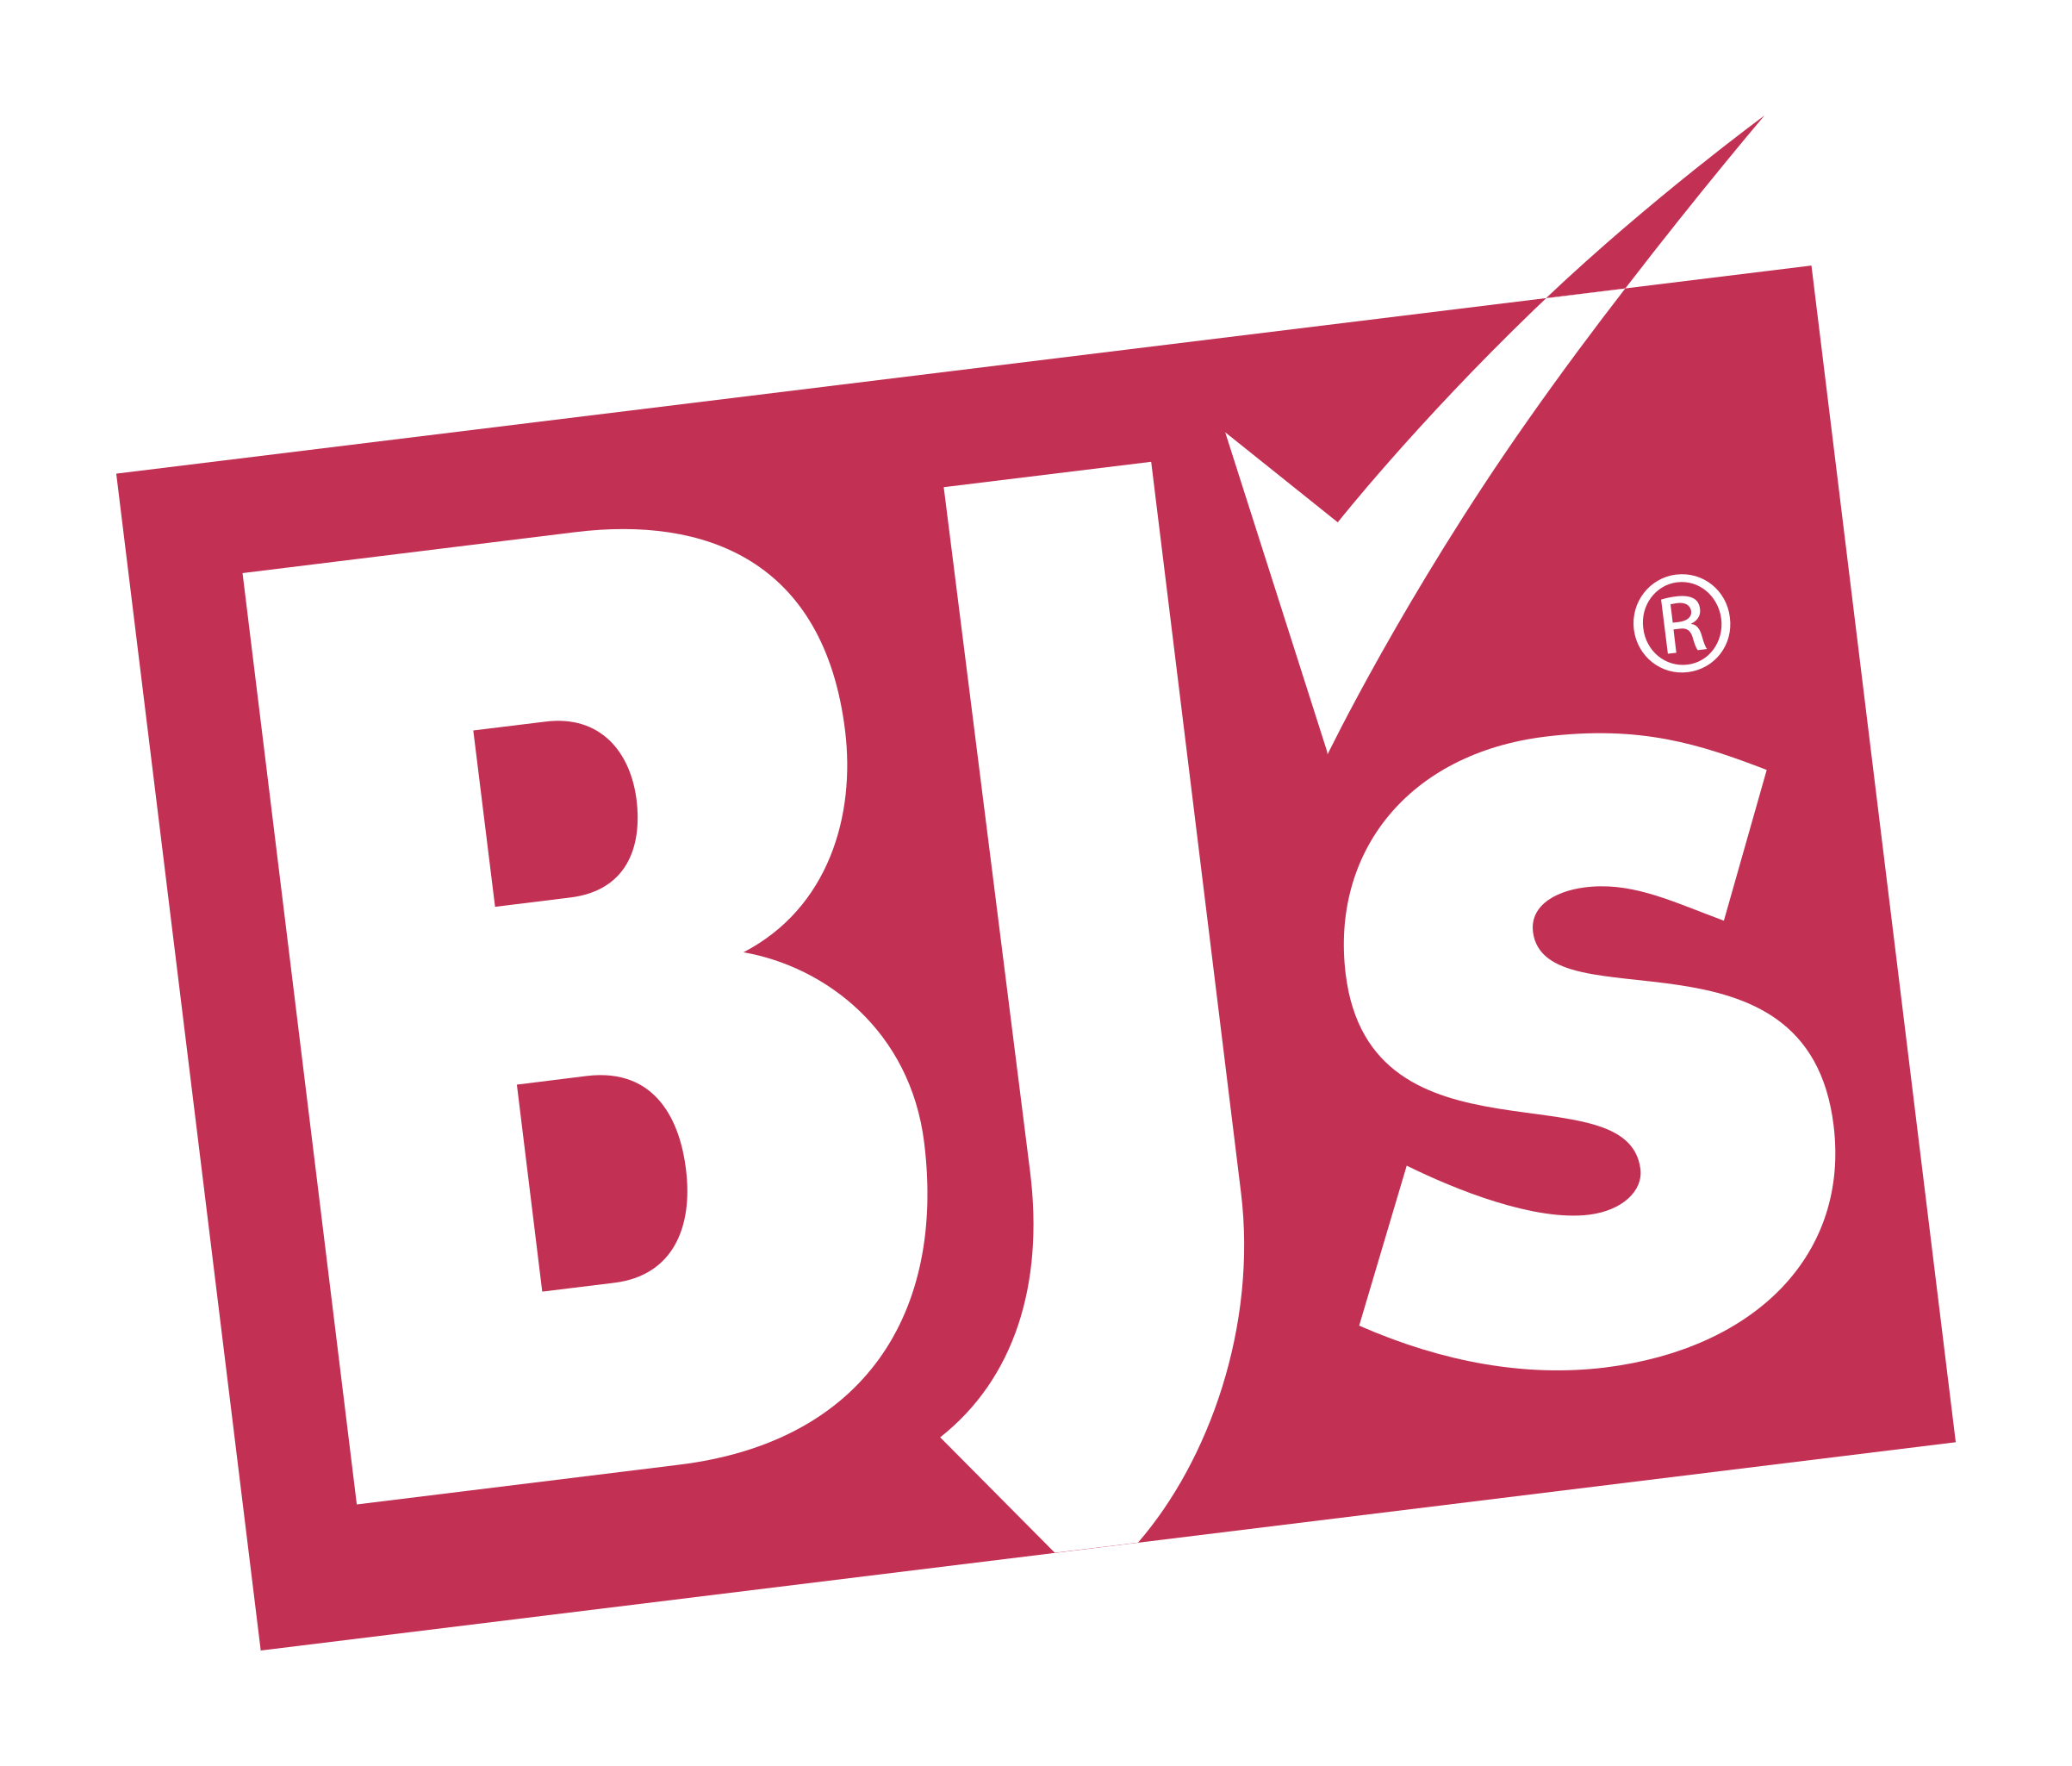
Liberty, SC Notes – Multi-Year Prospects
These brands are long-term, multi-year prospects. We are slowly but surely providing these retailers with exposure to Liberty. Several have made this list (REDACTED) because they will likely need to be a part of a new development project to enter the market.
National General Merchandise Retailer: We are beginning to see the brand develop new stores again.
National Hardware Retailer: Has been focused on improving in-store profitability but is now looking for new opportunities again.
National Rural General Merchandise Retailer: Active across South Carolina with multiple developers. They are willing to enter smaller, more rural markets like Liberty.
National Clothing Retailer: Will likely require a new development project to enter the market.
National General Merchandise/Discount Retailer: Very popular co-tenant for REDACTED developments.
National Warehouse Club: New England brand was a pioneer in the warehouse club model in the early 1980s. They are now in a nationwide expansion plan, with the Sun Belt/southeast being a major target for the coming years.
Regional Grocer: Retailer is looking to rapidly expand their footprint in South Carolina.
Regional Grocer: This brand, now owned by REDACTED, looking to push further into Carolinas markets in the coming years.

Slide 13
Liberty, SC – 2024 Recruitment Focus
Retail Types:
Quick Service Restaurants
Full-Service Restaurants
Gas Stations
Hotels
General Merchandise Retailers
Clothing Retailers
Multi-Year Prospects:
REDACTED
REDACTED
REDACTED
REDACTED
REDACTED
Big Picture Vision:
Establish Liberty’s unique market position with national retailers, their brokers, and developers.
Recruit large-market, Carolinas-based developers to actively monitor market for opportunities. Primarily looking to attract a new grocery-anchored shopping center development in Liberty.

Slide 14
Liberty, SC – 2024 Recruitment Focus
What is a “win” in 2024?:
We are always trying to influence retailers, brokers, and developers to get deals done as soon as possible. So, getting an announcement about a retailer opening in the market is always the ultimate goal, but we want to roadmap potential wins for calendar year 2024:
Expand field of viable prospects.
Influence multiple retailers to visit the market.
Help connect local property owners with brokers representing retailers.
Hotel feasibility study shared with developers for major brands (Hilton, Marriott, IHG, Cobblestone, etc.)
Work towards assisting on any major retail property sales that may occur during the year.
Proactively bring additional exposure to key existing retail vacancies in the market.
The process always requires patience – but as we enter our second year in the partnership, we believe there is significant positive momentum for 2024!

Slide 15
THANK YOU
Liberty, SC

